Slide 1



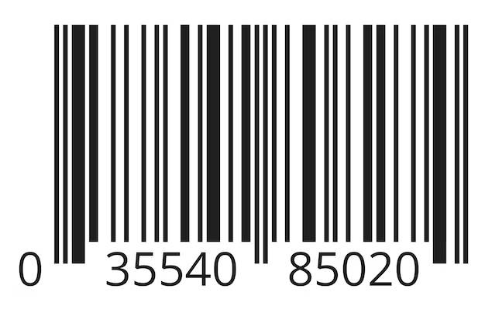
What to Do?
Find the item and scan the bar Code for Next step
Select the item:
Bar Code Scan Done!

Slide 2


What to Do?
Select The Item That you Want to Buy.
What you Selected?
T-shirt
For L,XL Size - $30
Blue
Red
Green

Slide 3

What to Do?
Select The Item That you Want to Buy.
What you Selected?
T-shirt
For L,XL Size - $30
Blue
Red
Green
Item Selection Done!

Slide 4
What to Do?
Place Your Order
What you Selected?
T-shirt
For L,XL Size - $30
Blue
Red
Green
Item
Style
Cost
T-Shirt
Red
$30
Total | $30
Place Order
Print

Slide 5
What to Do?
Place Your Order
What you Selected?
T-shirt
For L,XL Size - $30
Blue
Red
Green
Item
Style
Cost
Order Placed!
T-Shirt
Red
$30
Total | $30
Place Order
Print

